Slide 1
IEEE Techloop IRIS:Intro to Machine Learning

Slide 2
2 magical Words of this century
Artificial Intelligence
Computer Systems that minim human intelligence
AI is the new electricity
It’s everywhere It can beat chess masters
It is being used in every domain “even humanities”
Its rate of increase is increasing rapidly every tick…
We have a lot of data and a lot of opportunities Best time to get in is now

Slide 3
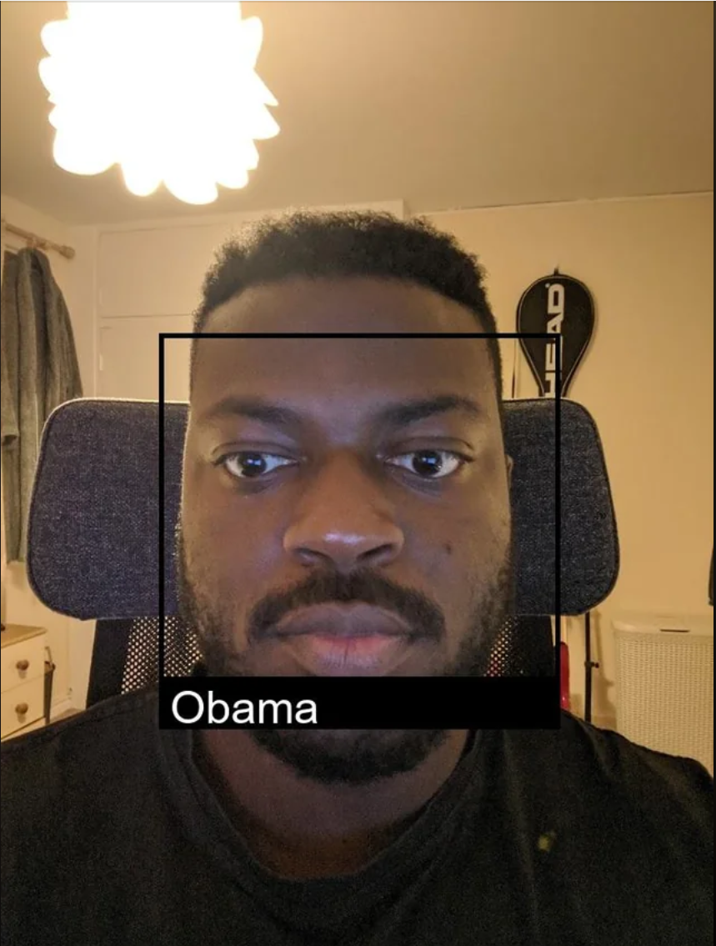

Slide 4
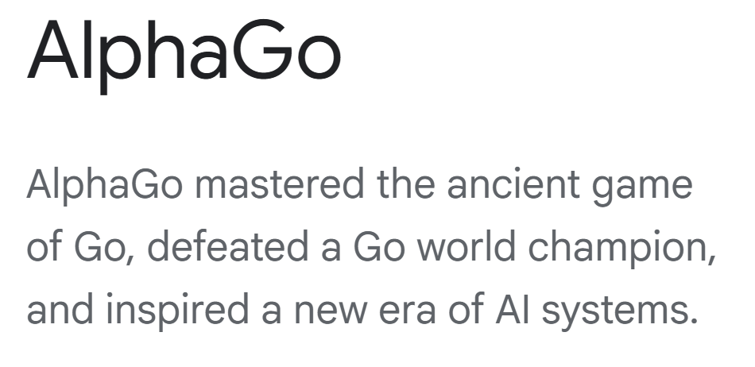
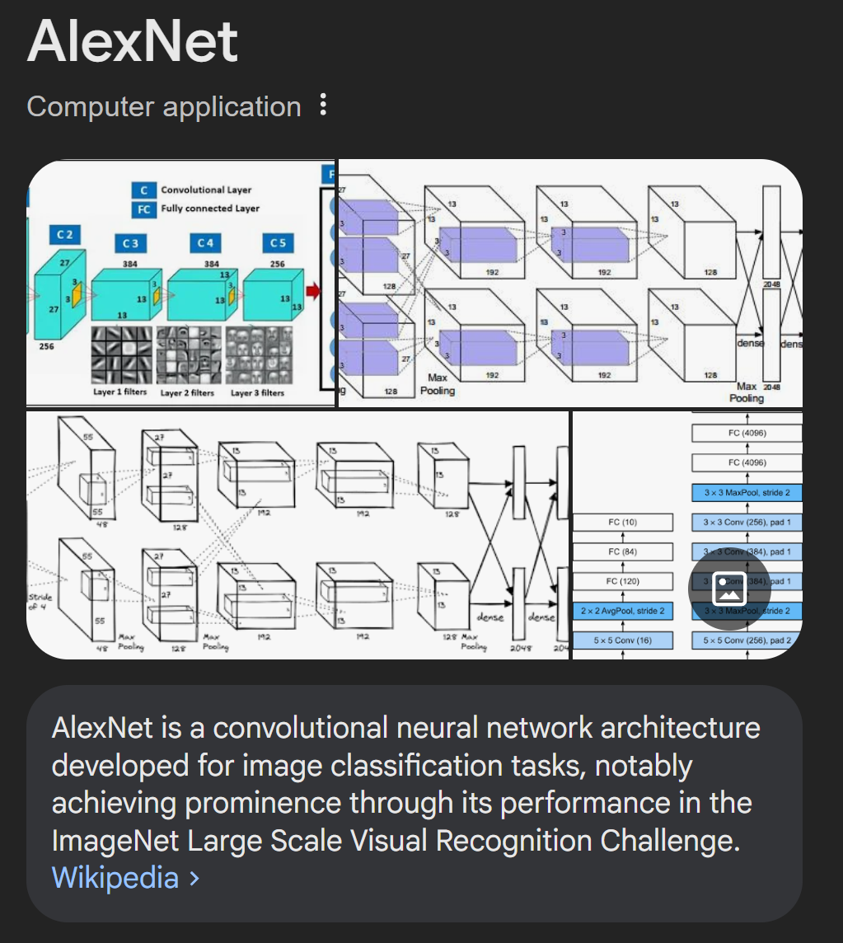
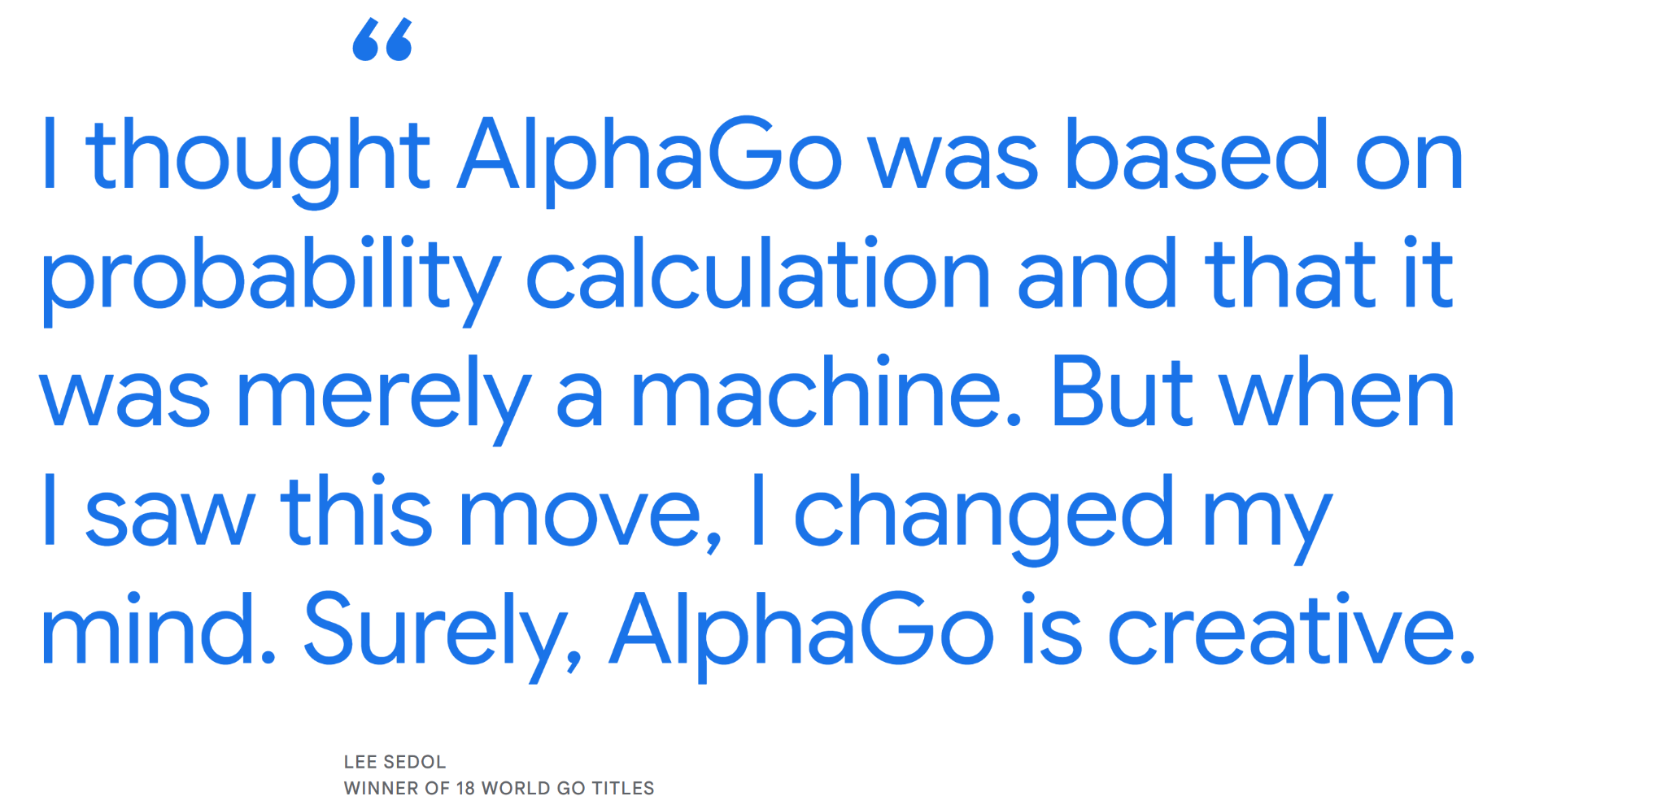
It wasn’t until the last decade when the area of NN really took off under deep learning

Slide 5
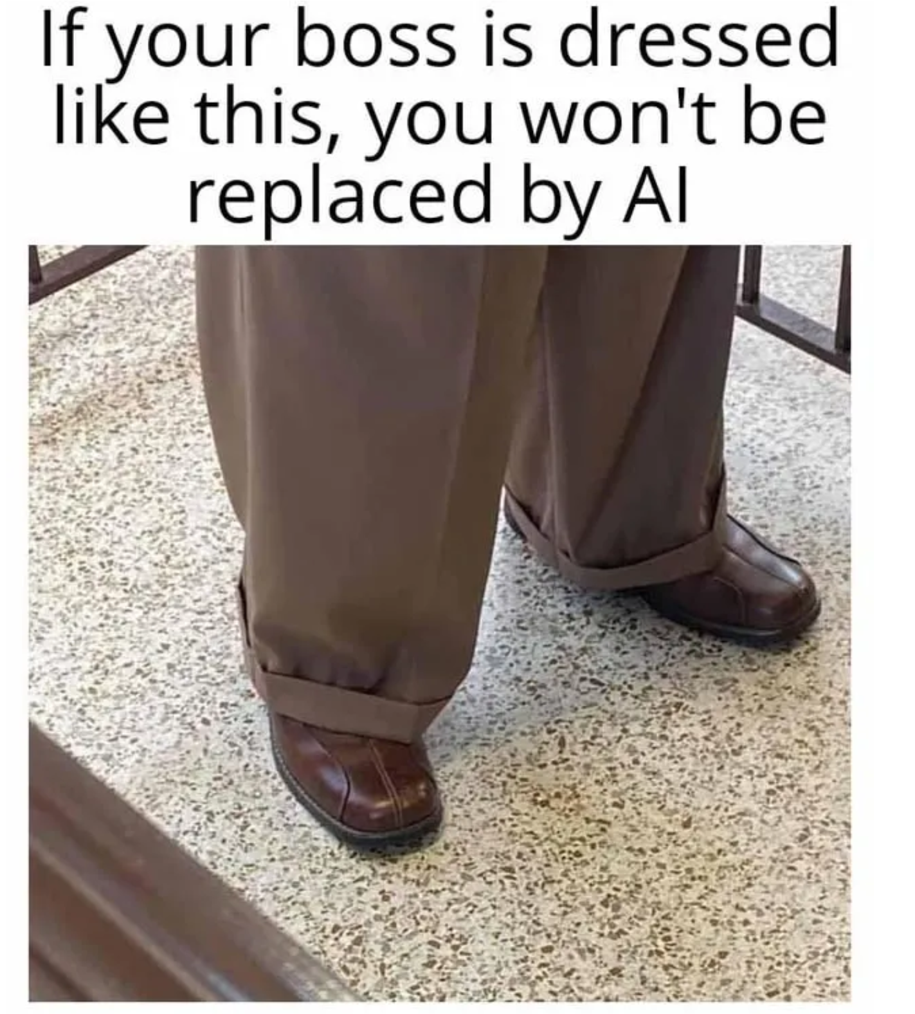

Slide 6
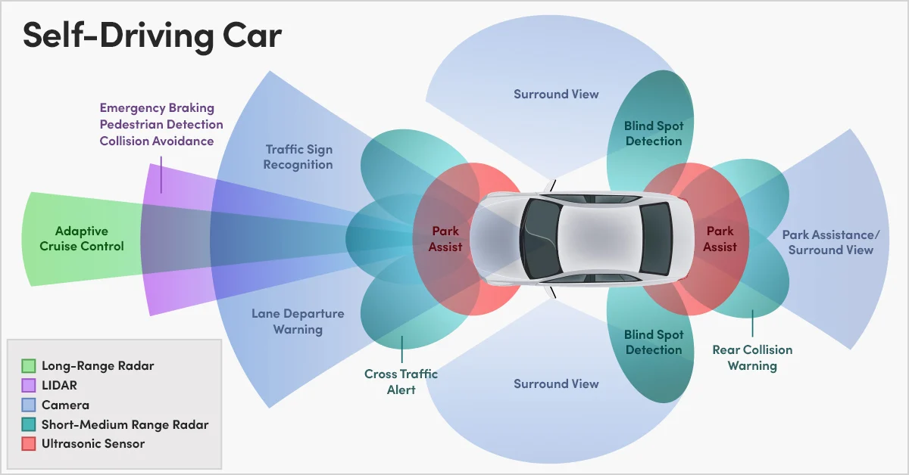
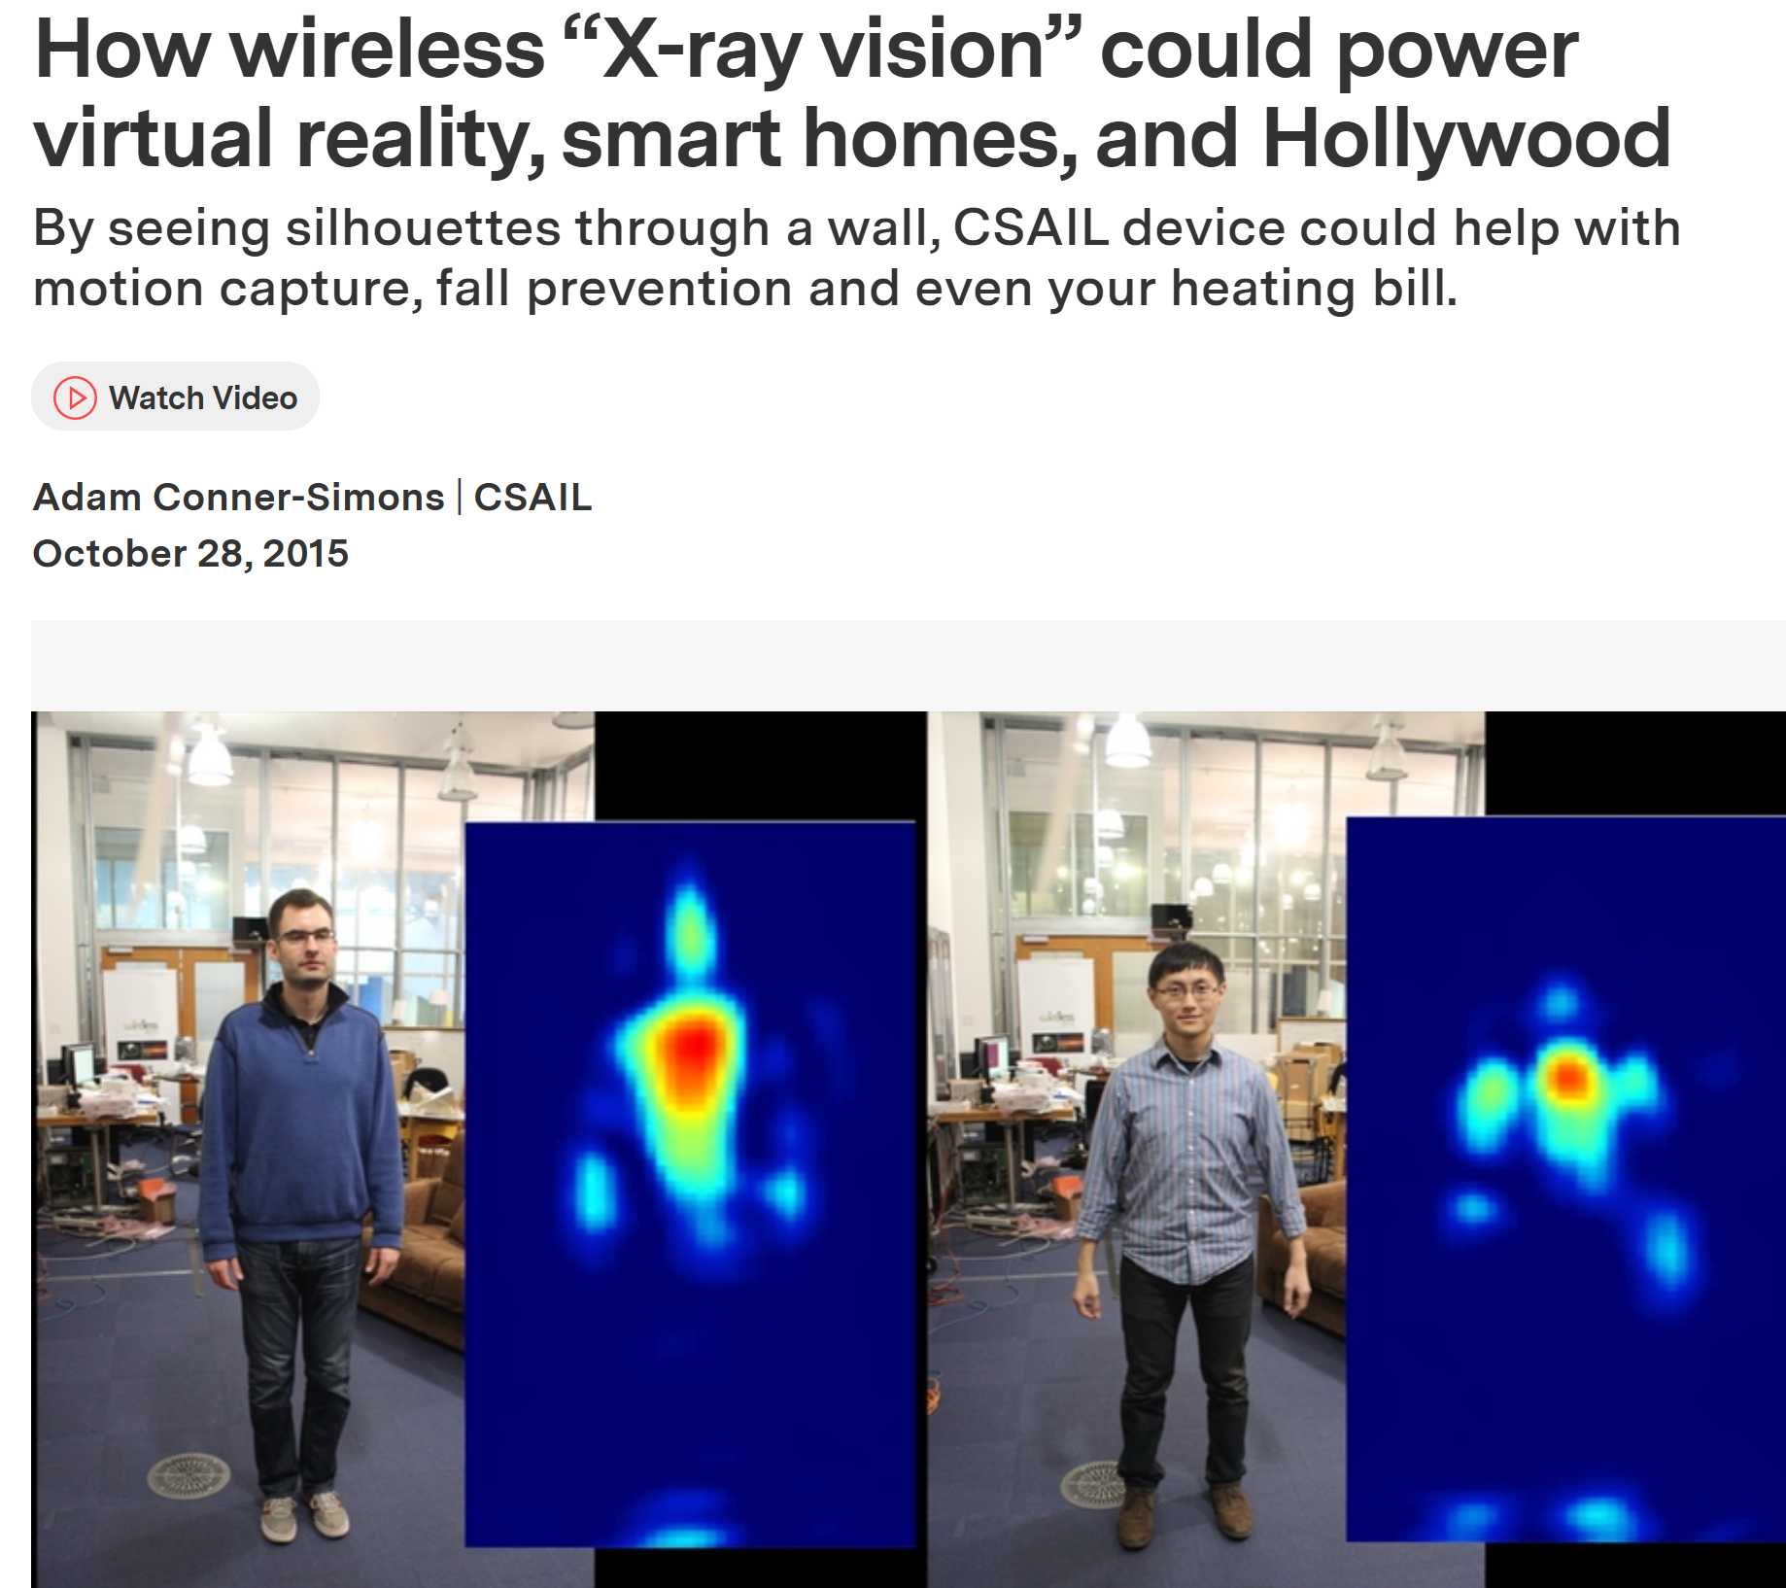
Machine Learning
Field of study that gives computer systems the ability to learn without being explicitly programmed.

Slide 7
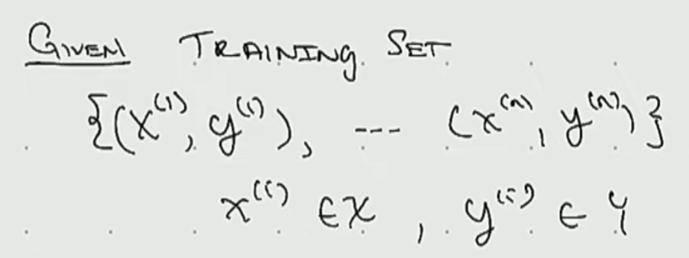
Supervised Learning
Learns from benign given the right answers Labelled data is used here
X—>Y Image —> Cat,Dog Text—> Is a joke ?

Slide 8
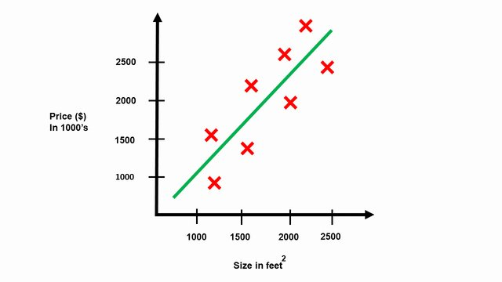
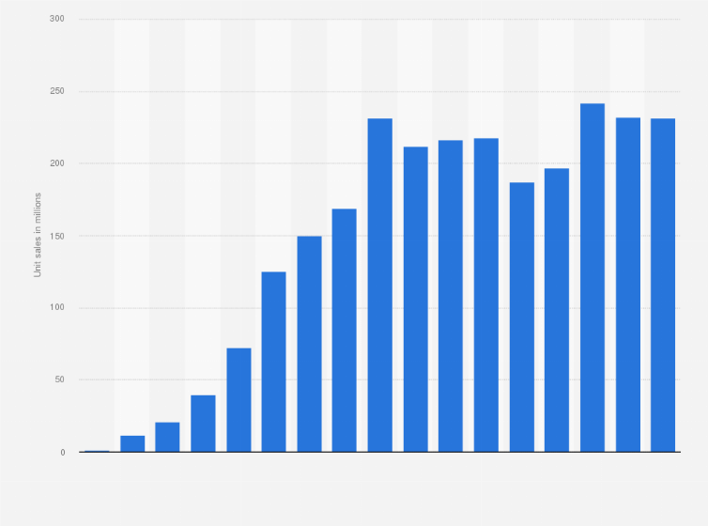
Regression
Housing Price Prediction
Iphone Sales Prediction

Slide 9
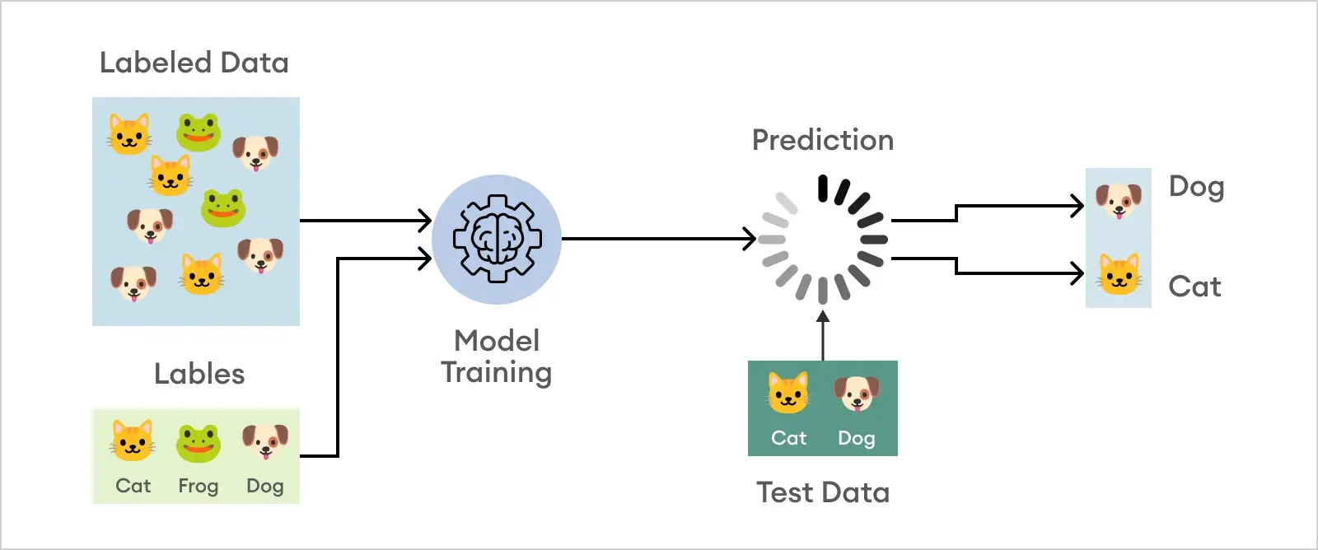
Classification

Slide 10


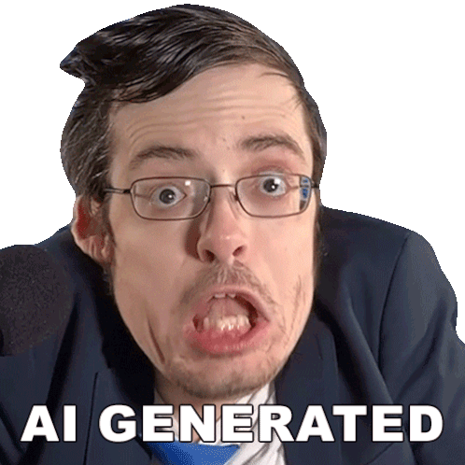
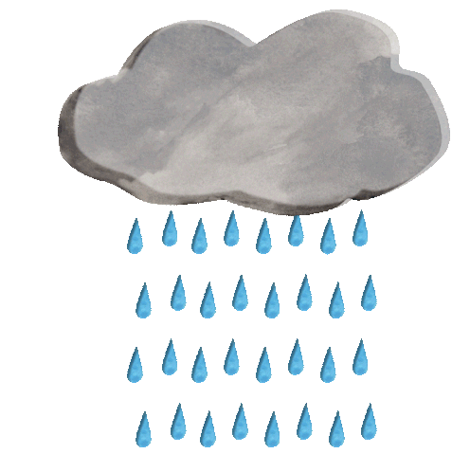
Tariffs
Tariffs
Tariffs
AI
AI
AI
Tariffs
Rain
Rain
Rain

Slide 11
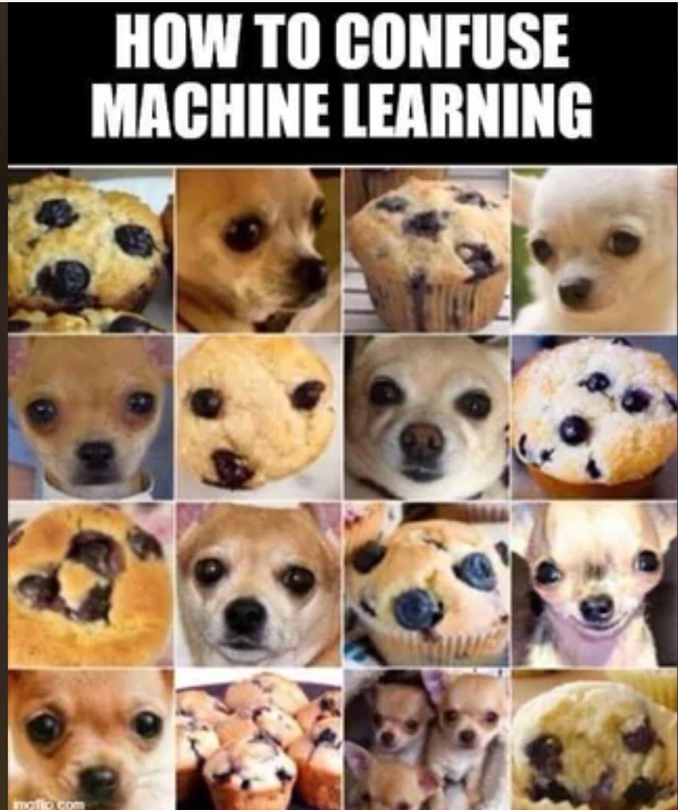

Slide 12
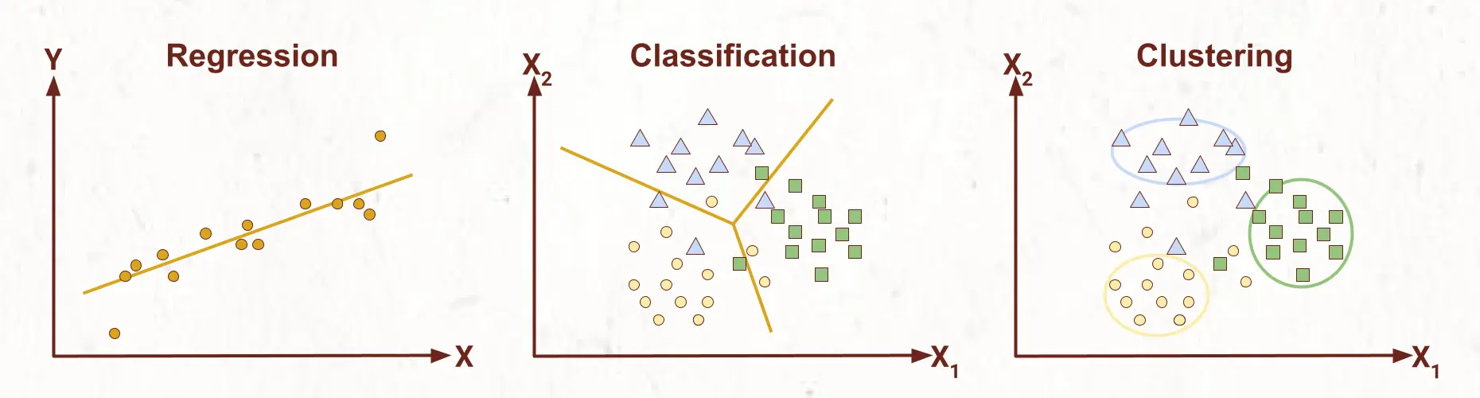
Unsupervised Learning
Unlabelled dataset Categorises data
It's learning patterns and structures from data without being given the right answers or labels.
Categorization of news articles about a topic.

Slide 13
Tax Related

Slide 14
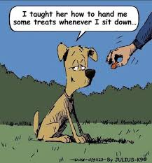
Reinforcement Learning
Learning based on rewards Room-mate training program
If they bring you water when you ask them:Reward If they don’t:No reward At the end it’s a happy ending

Slide 15
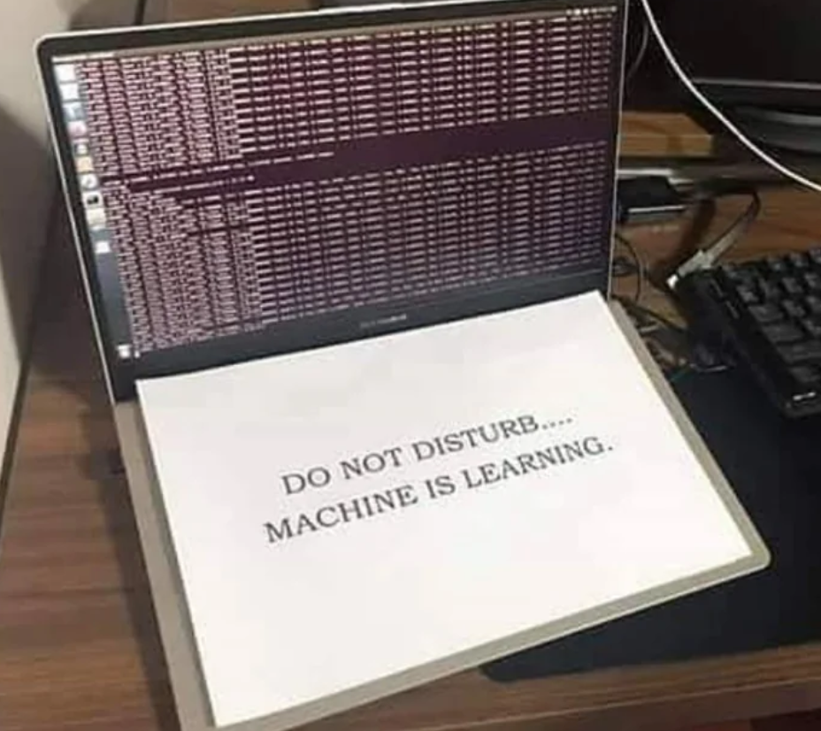

Slide 16
Data Analysis Session

Slide 17
Project

Slide 18
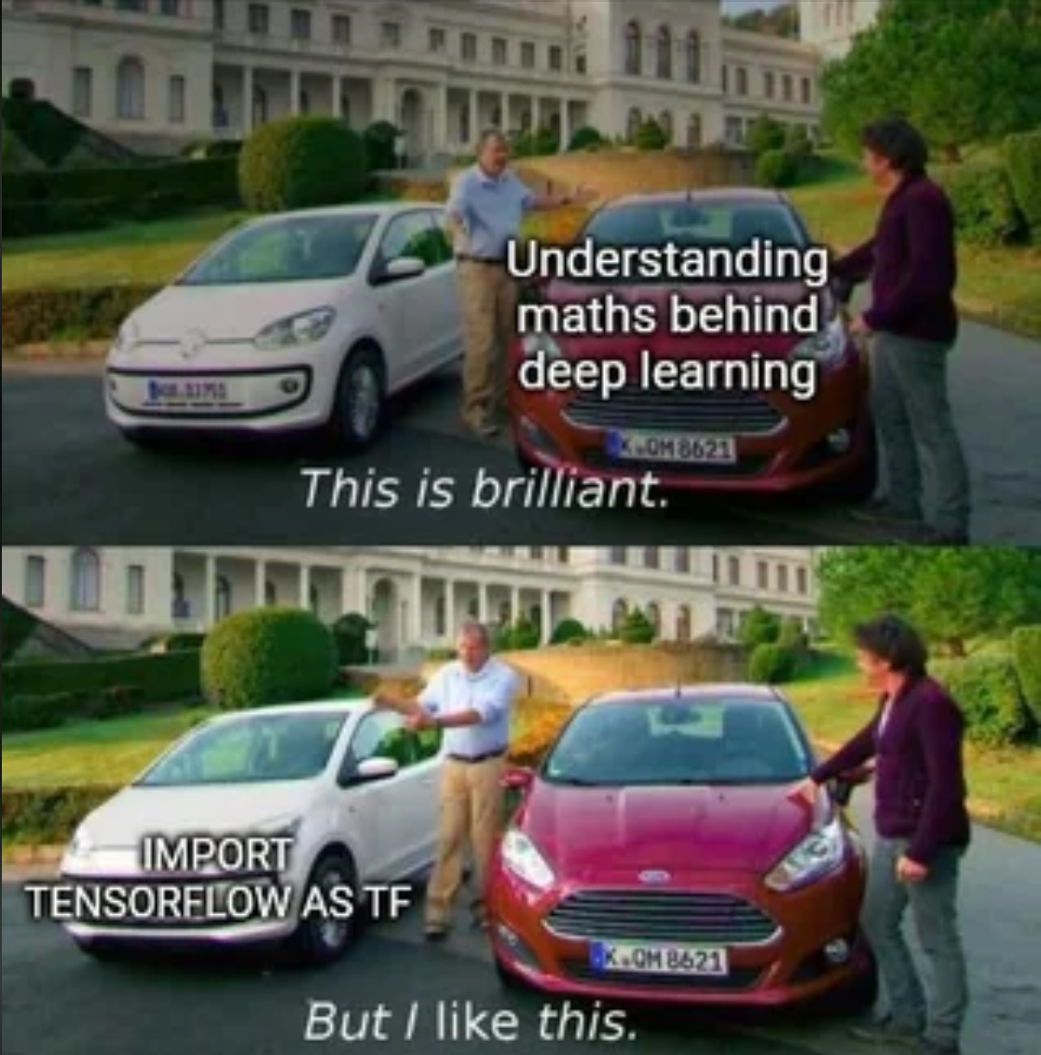

Slide 19
